Slide 1


CAPTCHA
Completely Automated Public Turing test to Tell Computers and Humans Apart

Slide 2
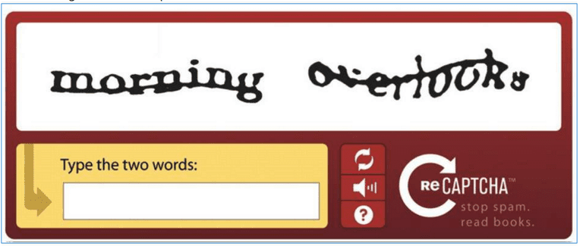
CAPTCHA
What does it mean?
A System which distinguishes human input and machine input
A way of preventing spams and automated extraction of data from websites
A distorted sequence of alphabets or letters or combination of both
A way to authenticate user before processing any sensitive data

Slide 3
CAPTCha types
Text CAPTCHA
Math Solving CAPTCHA
Picture Identification CAPTCHA
Visual CAPTCHA
Object Collage CAPTCHA

Slide 4
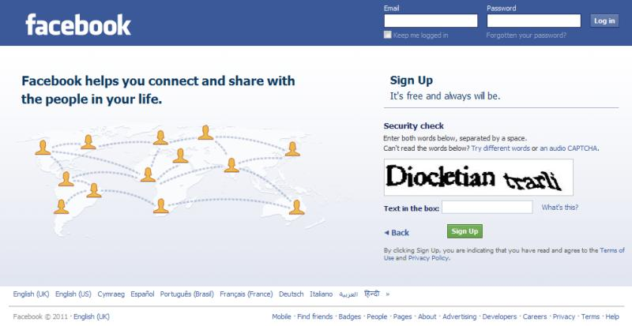
Types of captcha
Text CAPTCHA
The text CAPTCHA is the oldest form of validating users
The CAPTCHA is basically in the form of a sequence consisting letters, numbers or both
These CAPTCHA’s are often hard to read as the characters overlap and mixed making the user think twice before inputting
Most of the websites display only one captcha to validate, but there are websites that require the user to input more than one captcha to process the data

Slide 5
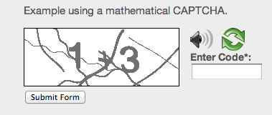
Types of captcha
Math Solving CAPTCHA
This CAPTCHA involves basic math to be solved by the users
These CAPTCHA’s provide the users with easy to read numbers that must be added or subtracted to pass it.
The idea behind this is that the developer’s don’t want the user’s to comment on their threads who fails to validate the CAPTCHA
This provides security to the application by allowing only the users who have basic understanding of the math to post or update the website contents

Slide 6
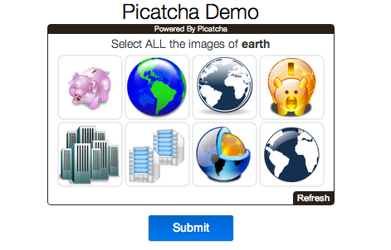
Types of captcha
Picture Identification CAPTCHA
This CAPTCHA requires the user to select the pictures that match the displayed question
This CAPTCHA’s are not harder to solve as the selecting images won’t go beyond the basic objects
This is the oldest form of validating users through picture identification
An advanced version of this idea is used by most of the websites today which consists of several blocks of images to select, matching the question

Slide 7
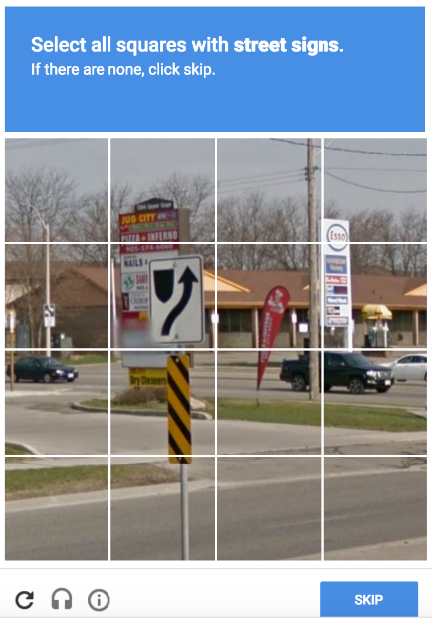
Types of captcha
Visual CAPTCHA
This is the advanced version of picture identification CAPTCHA but it is a bit harder to solve
The user needs to identify all the image blocks that match with the question
These CAPTCHA’s are hard to solve as a tiny portion of the object may be in a different block which requires keen observation of the user
These CAPTCHA’s often have a time limit and an option to reload if the user unable to solve the current CAPTCHA set

Slide 8
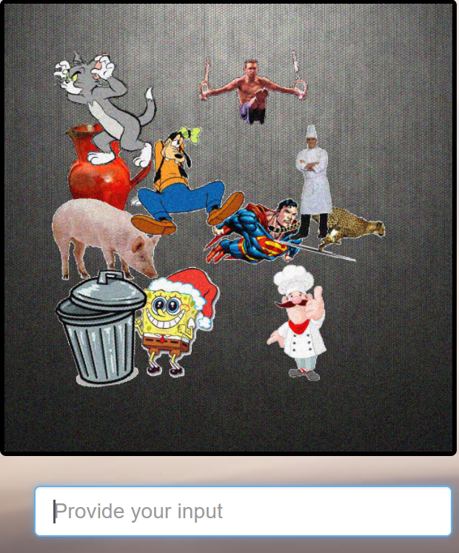
Types of captcha
Object Collage CAPTCHA
The object collage CAPTCHA consists of an image with a different combination of objects overlapped and attached together
These type of CAPTCHA’s are difficult to solve as the objects are overlapped to maximum extent with only minimal portion visible to the user
The objects often have the same color and contrast as that of the background which even makes it difficult to identiy
The questions are based on the type, length and action’s of the objects in the image

Slide 9



Captcha project implementation
In this project 3 different ways of CAPTCHA are implemented which includes text, visual and object collage
The project is split into two scenarios, CAPTCHA demo’s and CAPTCHA evaluation
The CAPTCHA demo’s are constructed to introduce users the types of CAPTCHA’s implemented, how they actually look and how they are validated
The users can evaluate 10 sets each of text, visual and object collage CAPTCHA’s to get a glimpse of them and the difficulty in solving them
A report is generated at the end for all the 30 attempts to check the success rate of the user

Slide 10
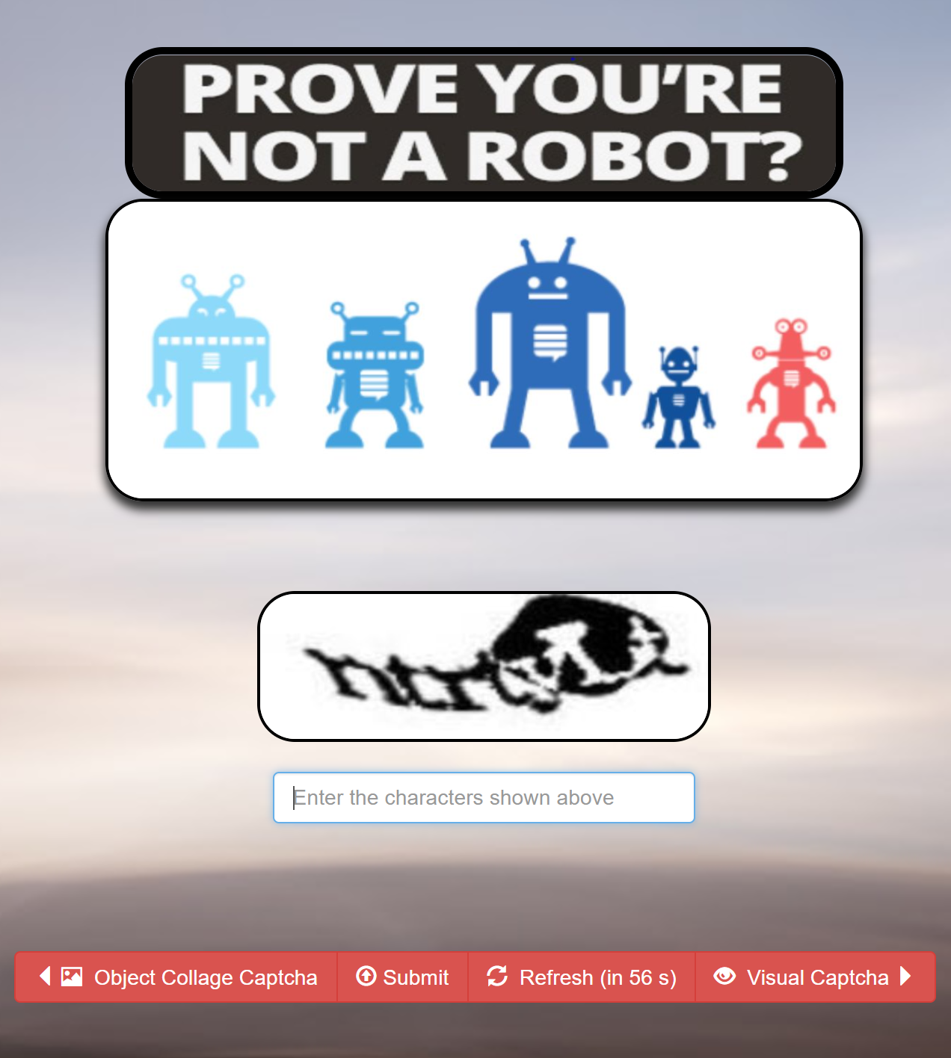
Text captcha demo
The characters should be entered as displayed in the CAPTCHA
The CAPTCHA is case sensitive. The user should watch for the uppercase and lowercase characters
The CAPTCHA can be reloaded any number of times with page refresh or by hitting refresh button
The user has 60 minutes to provide the input. After that the captcha will refresh automatically.
The user should provide his input before hitting the button ‘submit’

Slide 11
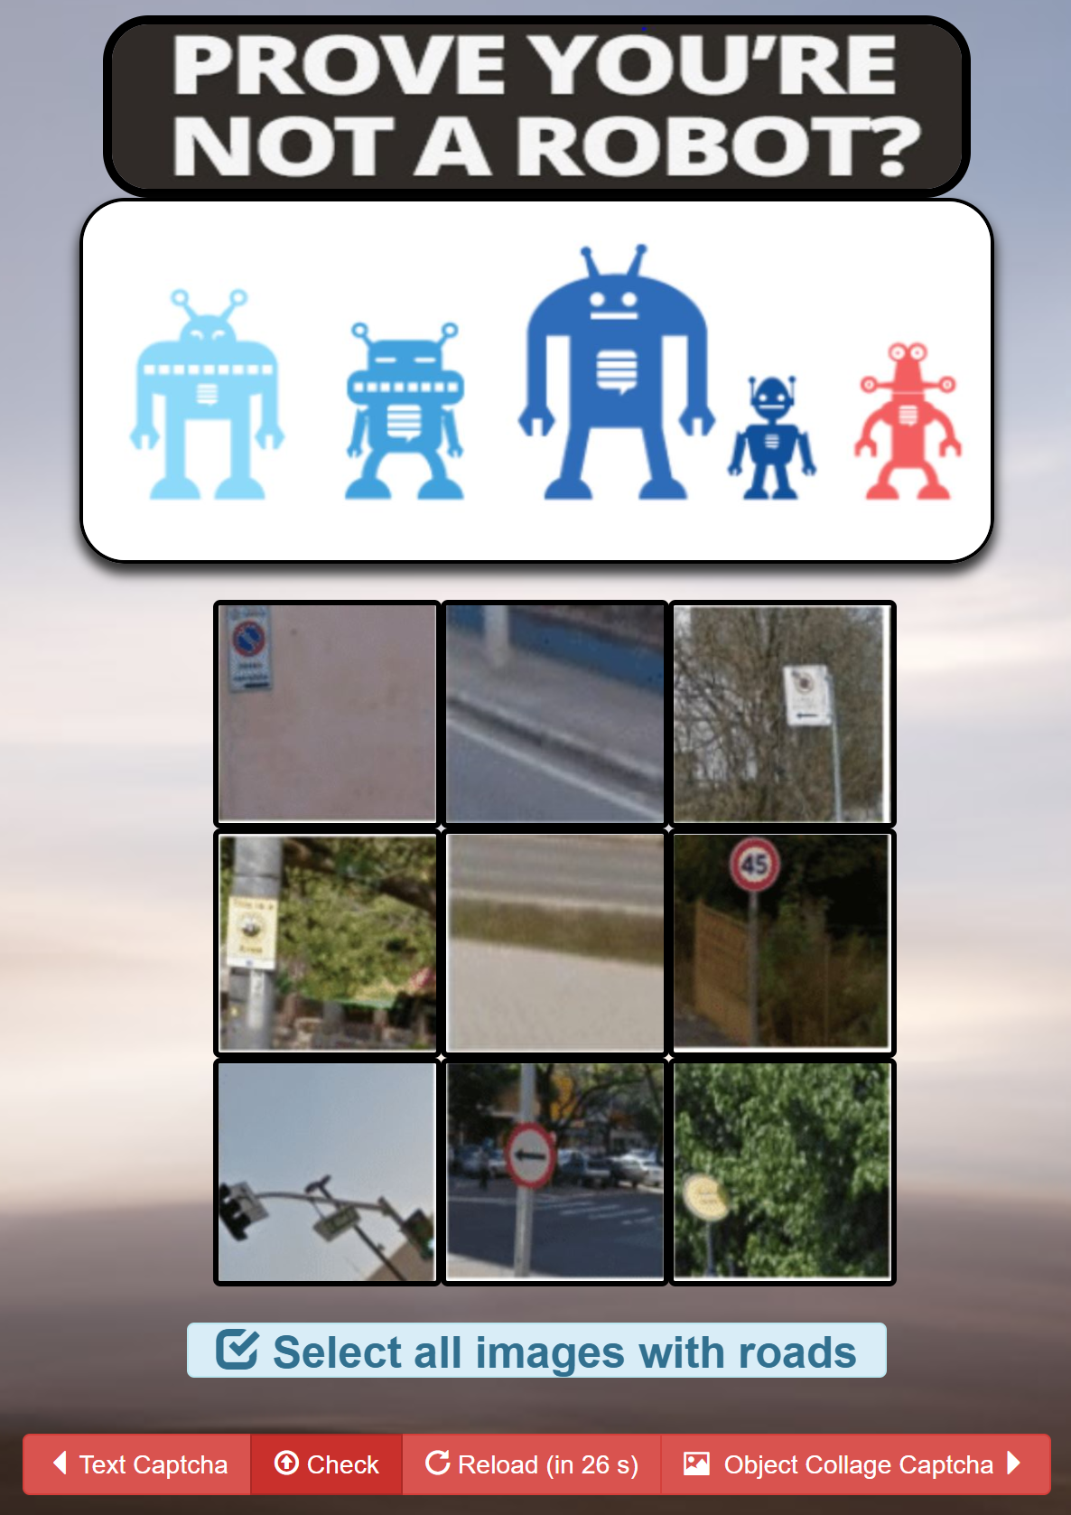
Visual captcha demo
The visual CAPTCHA is implemented in a 3X3 grid format
The user needs to select atleast one image to validate
The user will succeed when all the images matching the question are selected.
He has 60 seconds to select the images
Upon clicking submit a success/failure message is displayed
The images will refresh after 60 seconds, on page refresh or on hitting the reload button
In reality the grid can be larger than the one which is implemented

Slide 12
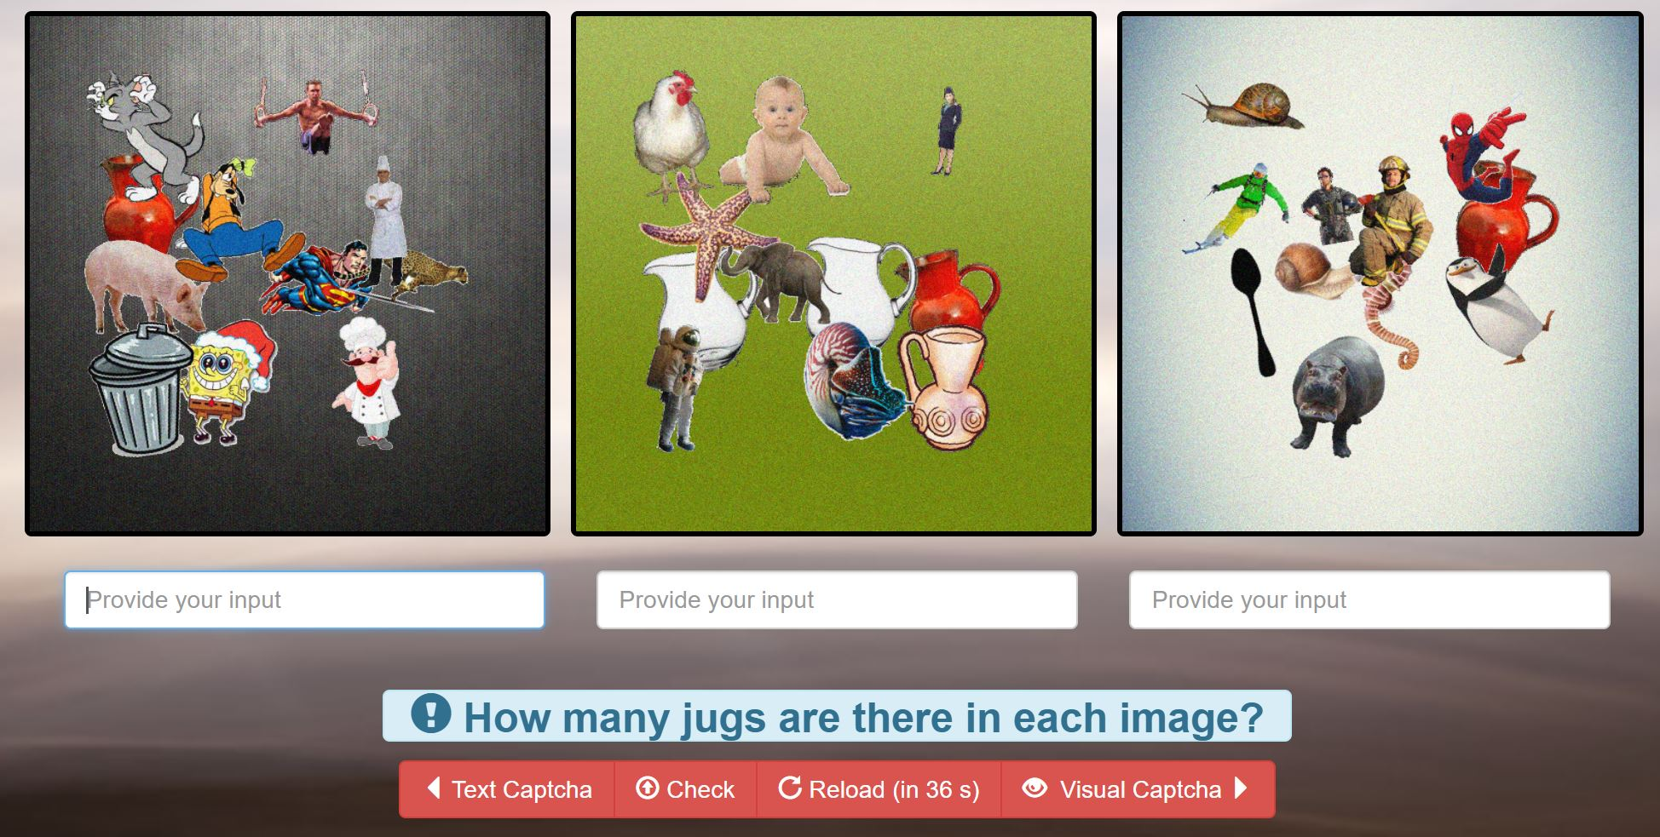
Object collage captcha
The object collage CAPTCHA requires the user to input the count of objects asked in the question
The user needs to fill in the correct input for all the 3 images for a successful validation
He has 60 seconds to provide input and click submit
If he finds difficult to solve
the current set he can refresh
the images by clicking reload
or by refreshing the page
After the time limit of 60
seconds the images will
refresh automatically

Slide 13
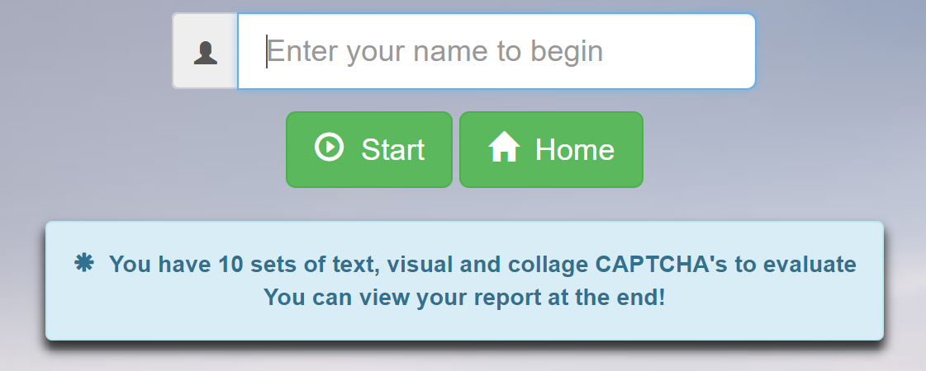
Captcha evaluation
The second scenario of the project is to evaluate the 3 types of CAPTCHA’s
The users are allowed to evaluate 10 sets of each
text, visual and collage CAPTCHA’s
Inorder to evaluate, the user needs to provide his name
which is later used to generate report
The user evaluates 10 sets of text captcha followed by visual and object collage CAPTCHA’s
After 10th text captcha set the visual captcha will be loaded automatically
After 10th visual captcha the object collage captcha will be loaded automatically
After 10th collage captcha a report with all the results for 30 attempts is generated

Slide 14
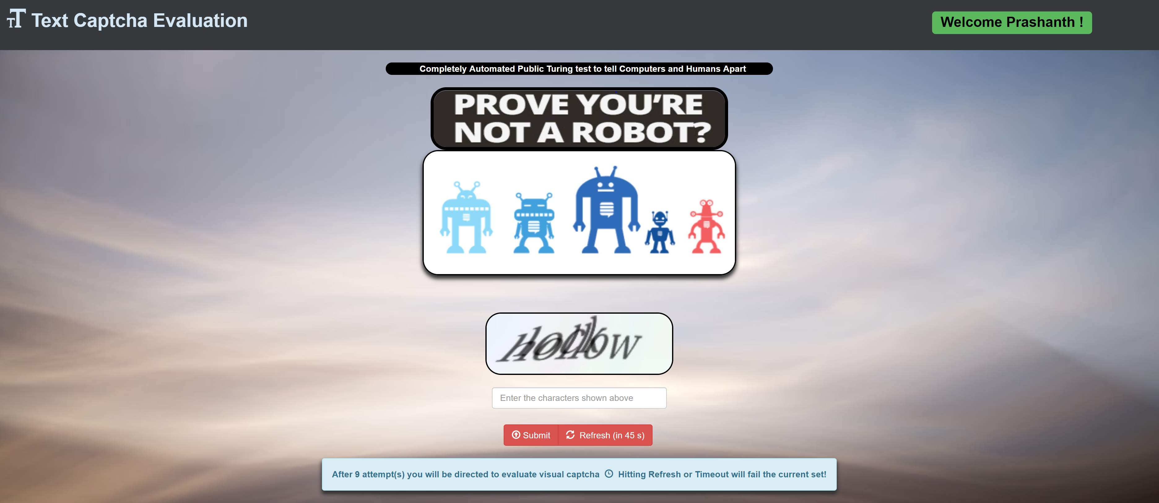
Text captcha evaluation

Slide 15
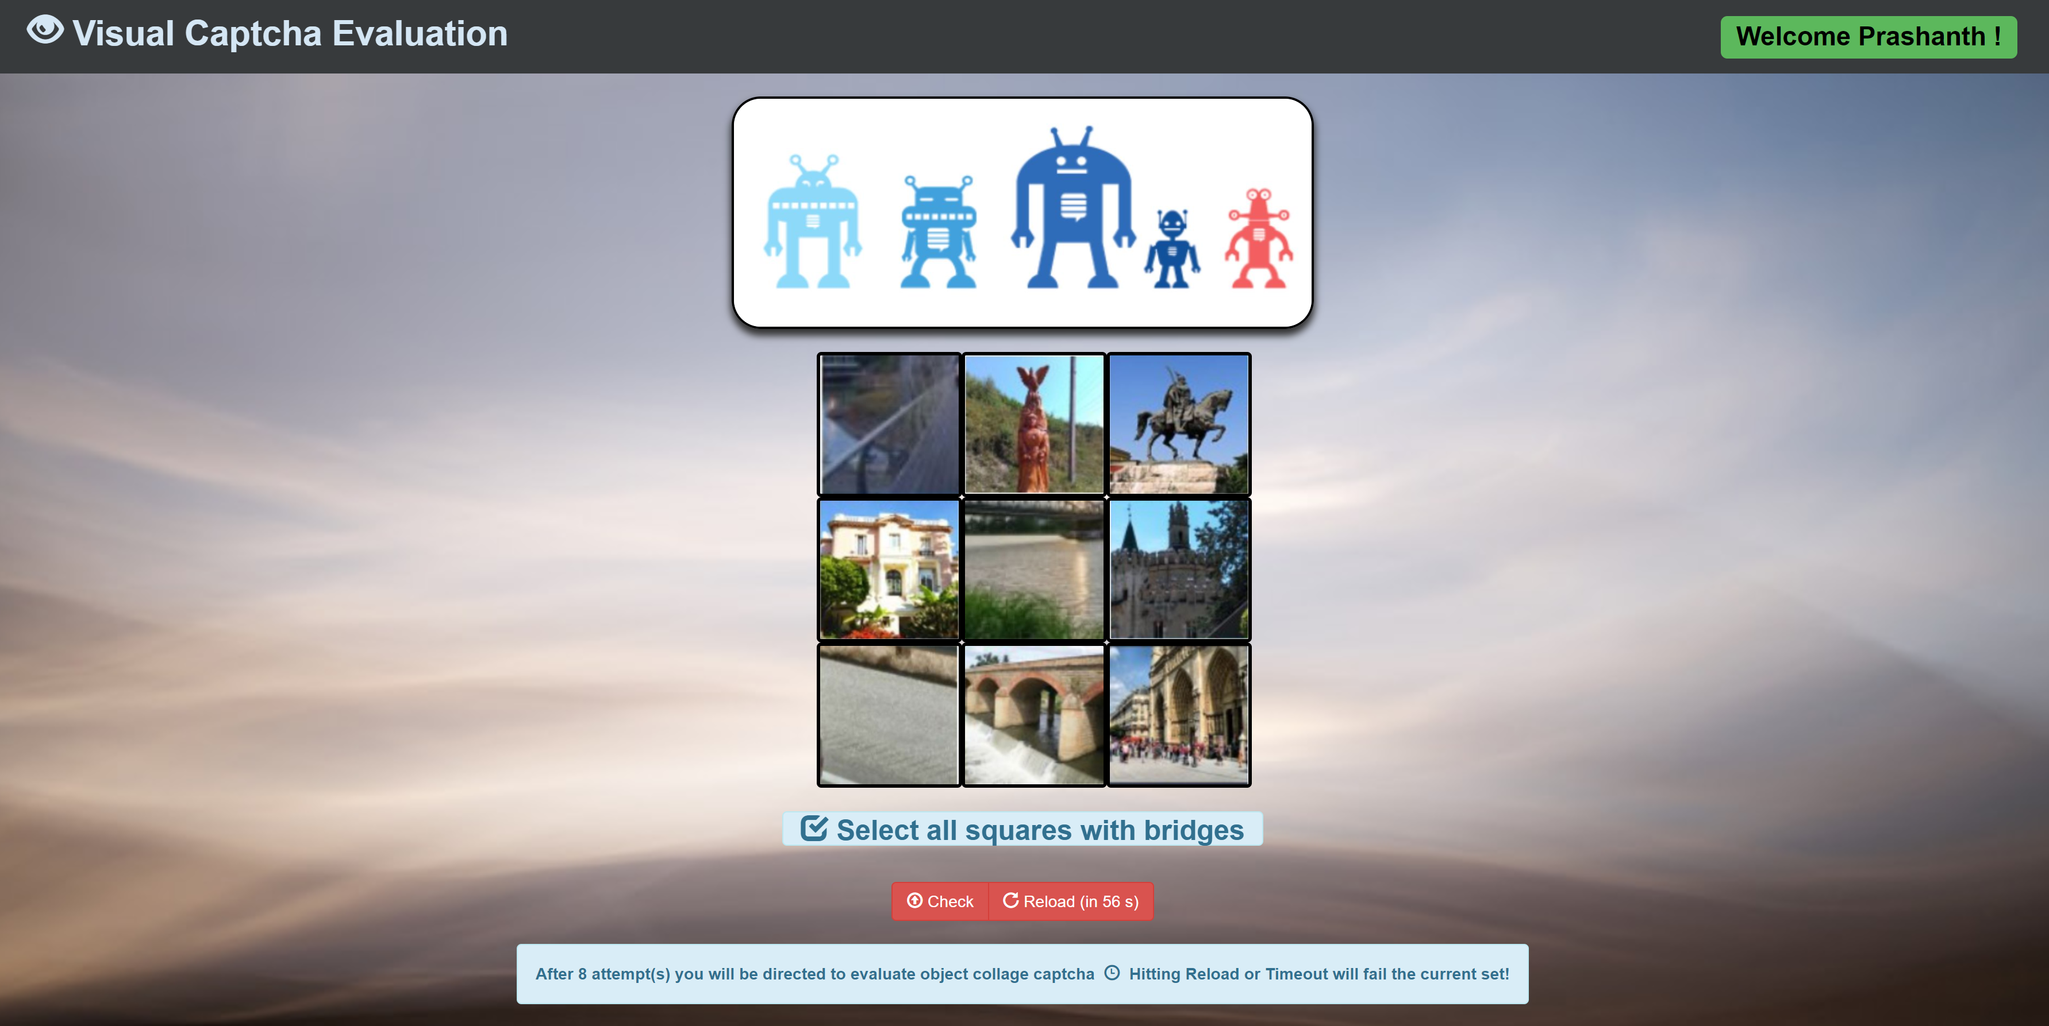
Visual captcha evaluation

Slide 16
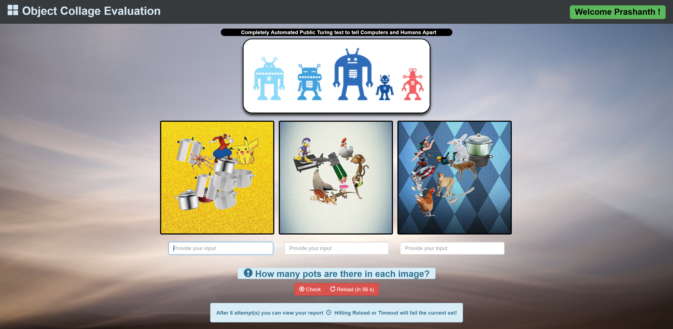
Object collage captcha evaluation

Slide 17
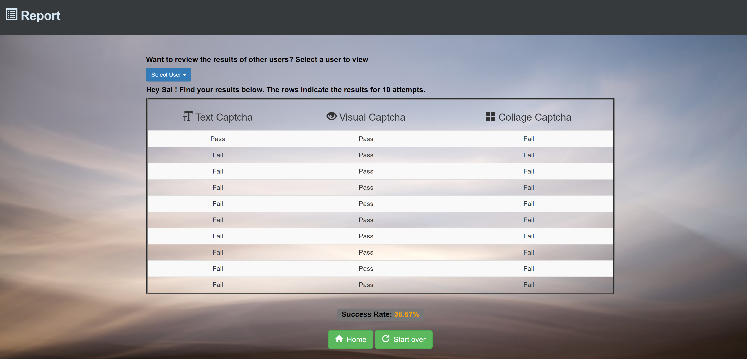
report

Slide 18
Thank you!

